Slide 1

Ashwin (alakshm6)
Gaurav (garadhy)
Stuti (snanda)

Slide 2
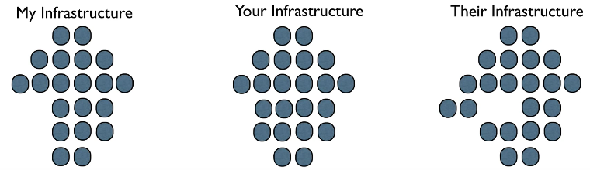
Managing multiple infrastructures can be daunting ...
Infrastructure can expand quickly
With growing components, complexity increases

Slide 3

You don’t want to end up wondering ...
How did I do that?
Who changed that?
Why did I do it that way?
And when a component dies ...
I have to rebuild this again, figuring out ways in which infrastructure components fit together.

Slide 4
Chef to the rescue ...
Automation framework for automating infrastructure and applications
Configuration management tool
Infrastructure as code
Written in Ruby, Erlang
Infrastructure aware
Idempotent

Slide 5
What does it do ...
Provision
Configure
Deploy
Orchestrate
“ Documentation : Code :: Chef : Infrastructure ”

Slide 6
Chef Terms ...
Knife
Recipe
Cookbook
Runlist
Marketplace

Slide 7
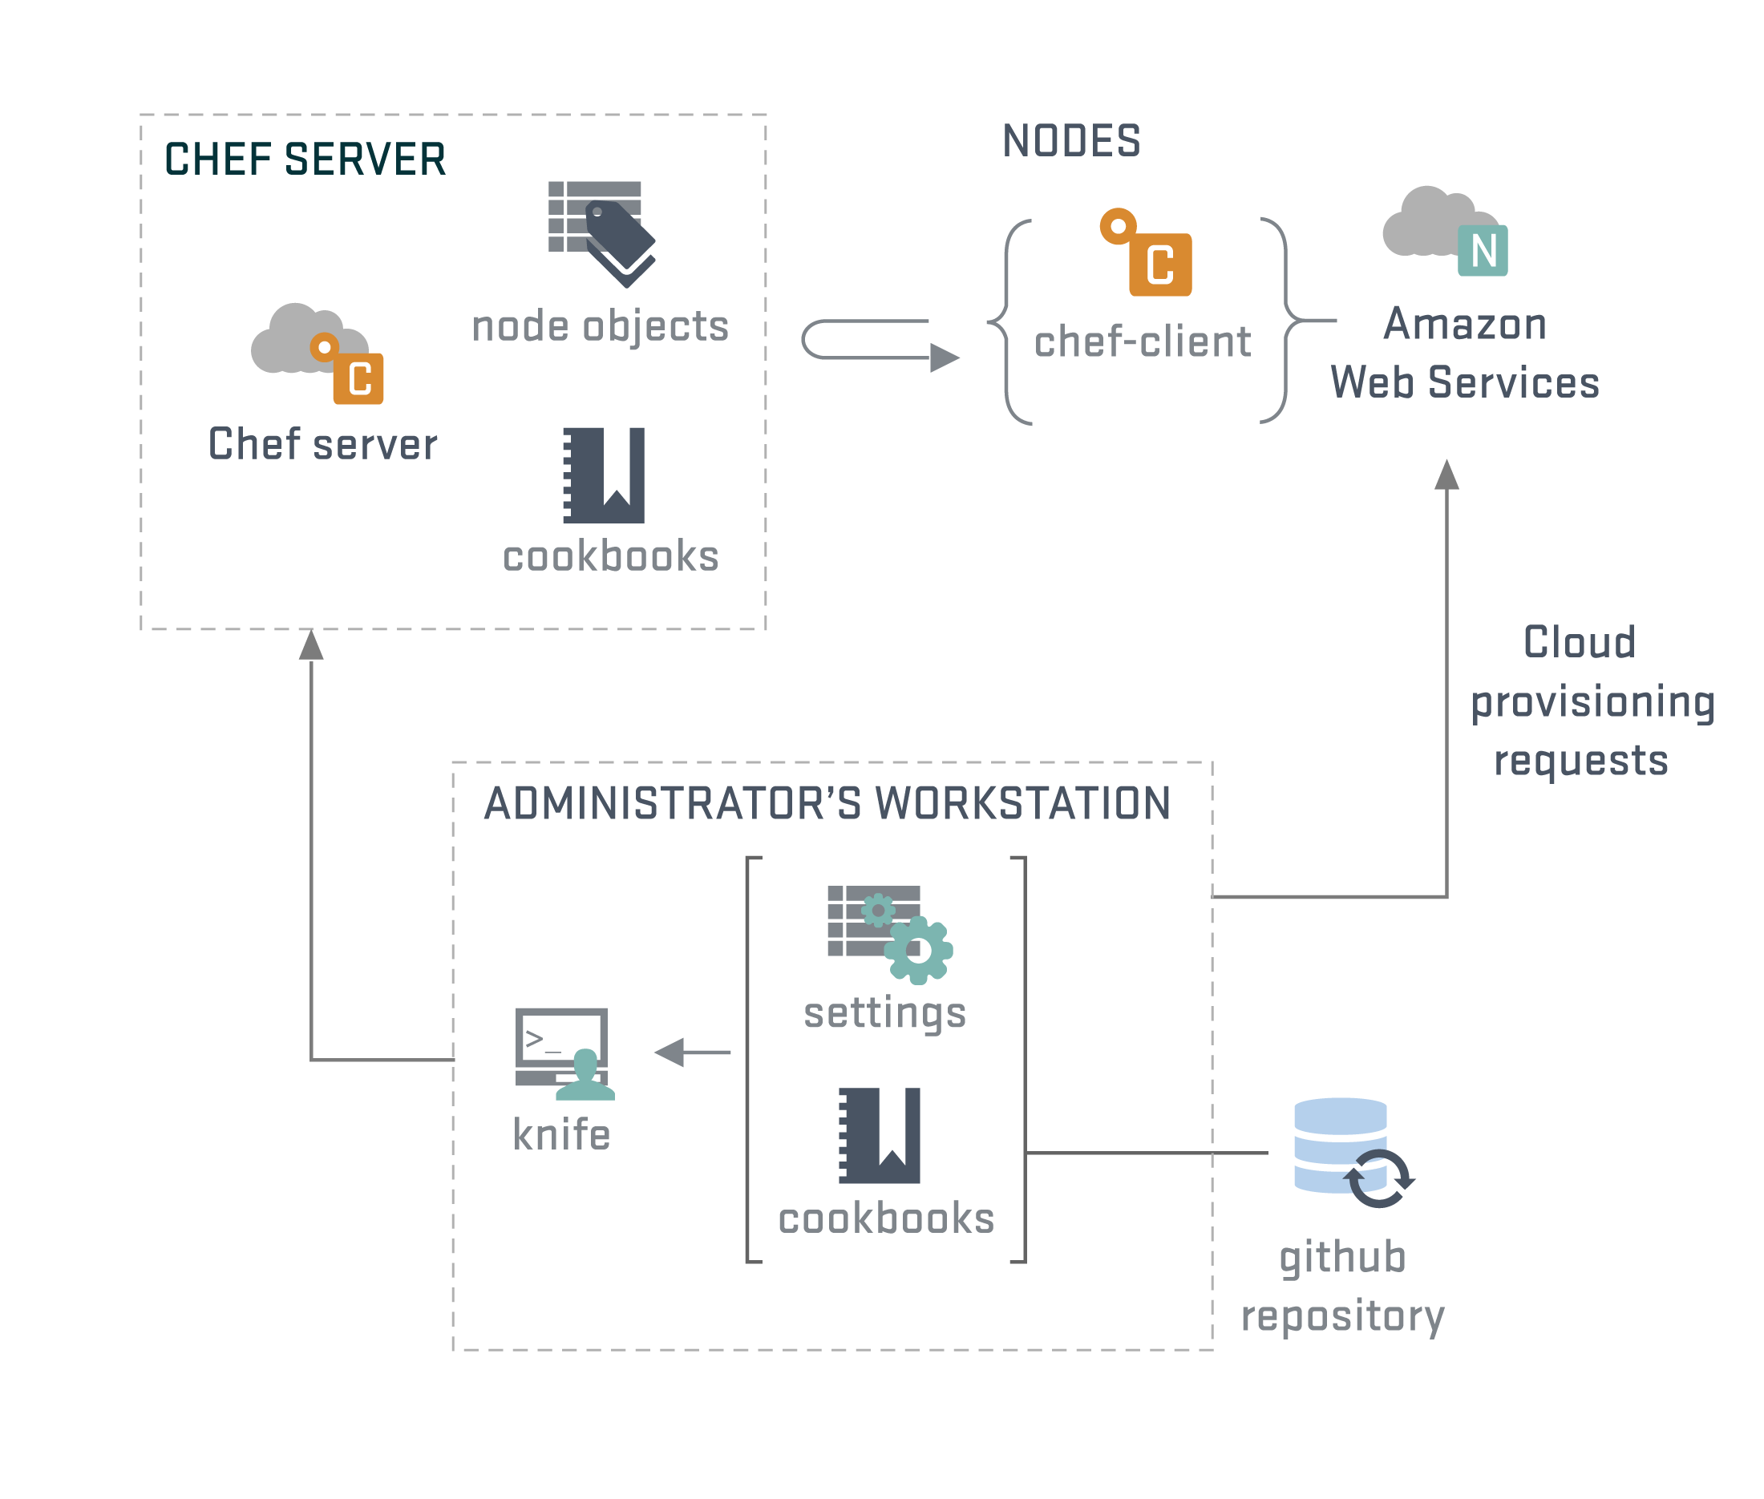

Slide 8
With Chef, you can manage ...
Packages
Services
Users, Groups
Networking
Files, Directories
And anything you can think of .... (Well, not everything!)

Slide 9
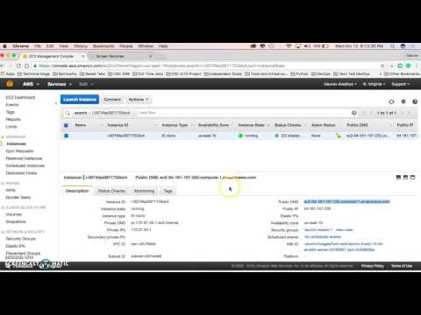

Slide 10
Chef vs Ansible
Learning Curve
Adoption constraints (developers vs admins)
Ease of use
Maturity
Community
Pull vs Push Model

Slide 11

Thank you!

Slide 12
Resources:
https://www.chef.io/
http://www.slideshare.net/AmazonWebServices/chef-cookbook-workflow
https://www.upguard.com/articles/puppet-vs.-chef-revisited
http://www.slideshare.net/adamhjk/infrastructure-automation-with-chef
http://www.slideshare.net/JulianDunn/chef-introduction-princeton-meetup
http://www.slideshare.net/vhata/devops-and-chef/42-SERVER_chefclient_on_node_use
http://www.slideshare.net/jweiss/infrastructure-automation-withchef

Slide 13

Questions ?

